Slide 1
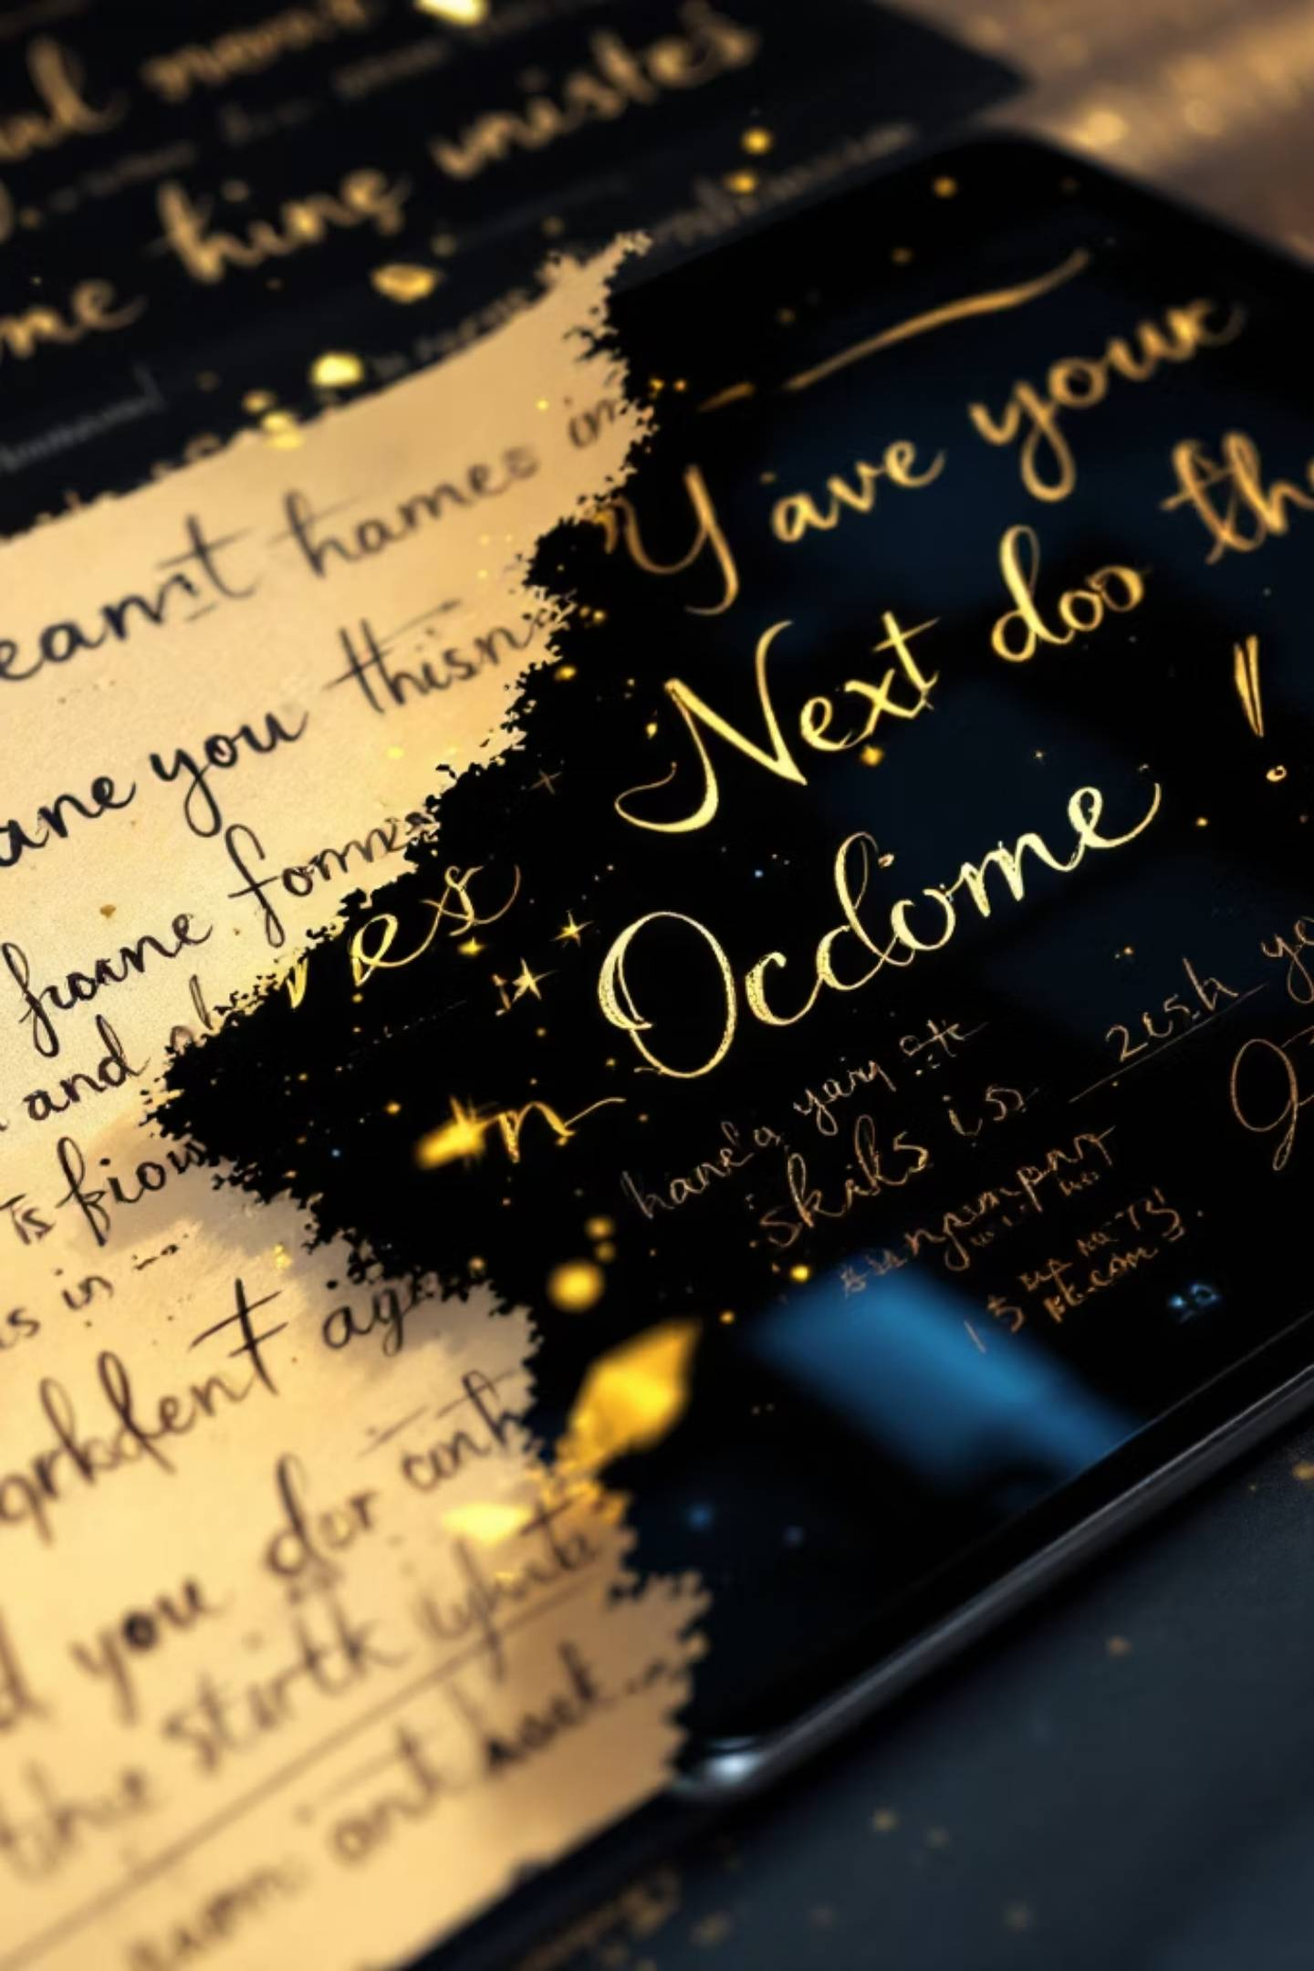
Scribble to Digital
Transform messy handwritten notes into clean, structured digital text using AI-powered OCR and intelligent processing.

Slide 2




The Challenge
Poor Lighting
Unclear Handwriting
Mixed Content
Low-quality images reduce text recognition accuracy
Varied writing styles make manual transcription time-consuming
Notes combined with tasks require manual separation
Students and professionals face productivity challenges when converting handwritten content to digital format.

Slide 3





How It Works
Upload Image
Handwritten notes captured via phone or scanner
Enhance & Extract
OpenCV improves image, OCR converts to text
AI Correction
Gemini fixes grammar and reconstructs text
Extract Tasks
Identify and organize actionable items

Slide 4

Core Technologies
Streamlit
Interactive frontend framework
OpenCV
Image preprocessing and enhancement
OCR Engine
Tesseract/EasyOCR for text extraction
Google Gemini 2.5 Flash
Python Backend
Contextual understanding, grammar correction, and smart task extraction
Core processing engine with modular architecture

Slide 5

Image Enhancement Process
01
Grayscale Conversion
Remove color noise for cleaner processing
02
Brightness & Contrast
Adjust levels to improve visibility
03
Noise Reduction
Filter out imperfections and artifacts
04
Thresholding
Apply binary filters for OCR optimization
Enhanced images ensure higher text recognition accuracy even for low-quality or unclear handwriting.

Slide 6

AI-Powered Text Correction
What the AI Handles
Corrects spelling errors automatically
Improves grammar and sentence structure
Reconstructs incomplete or unclear words using contextual understanding
Formats text into readable paragraphs
Result
Messy handwritten content transformed into professional, well-structured digital text.

Slide 7

Automatic To-Do Extraction
Intent Analysis
Action Item Detection
AI analyzes sentence structure to detect task-oriented statements
Identifies and extracts actionable items from mixed content
Structured List
Organizes tasks into clean bullet-point format for quick reference
Separates important tasks from general notes, improving productivity and task management.

Slide 8
System Architecture
Streamlit Frontend UI
Simple web interface for image uploads and dynamic result display
Image Processing Layer
OpenCV enhances images through preprocessing techniques
OCR Layer
Extracts raw text from processed images
Generative AI Layer
Gemini 2.5 Flash corrects, formats, and extracts tasks
Export Module
Converts content to PDF, Word, or text formats

Slide 9



Testing Results
95%
85%
70%
Clear Handwriting
Medium Quality
Poor Quality
Accurate OCR extraction with proper grammar correction
Context-based correction improved sentence clarity
Partial extraction with contextual enhancement
System successfully processed various handwriting styles, lighting conditions, and content types with consistent error handling.

Slide 10

Key Takeaways
Modular Architecture
Separation of concerns ensures maintainability and scalability
Intelligent Processing
Gemini AI provides contextual understanding beyond simple OCR
Practical Value
Saves time for students and professionals through automation
Team: Panneer Selvam M (Leader), Anto Newton X, Sanjay Kumar C, Sivanesan M, Naveen V

